Slide 1
Start your API Testing journey with Postman

Slide 2
Start your API Testing journey with Postman
Saurabh Dhingra

Slide 3
What is API?
API stands for Application Programming Interface which helps two independent software to communicate with each other.
An API has functions and modules which help one system to communicate with another system which further helps in data exchange.

Slide 4
What is a web service?
When an API communicates over Internet over HTTP protocol is know as a web service.
Example –
Login via Facebook and Gmail
All kind of aggregator websites like makemytrip.com, yatra.com etc.

Slide 5
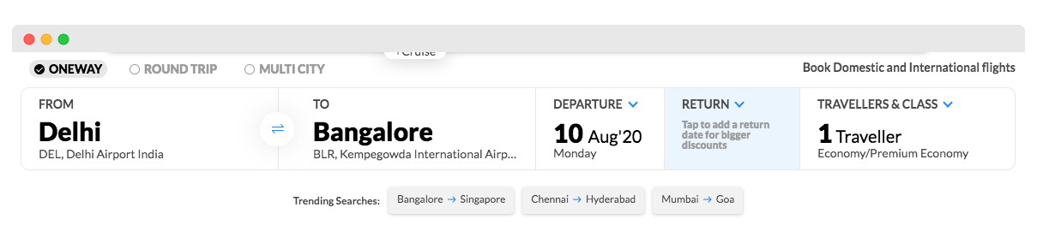
Let’s talk about MakeMyTrip…

Slide 6
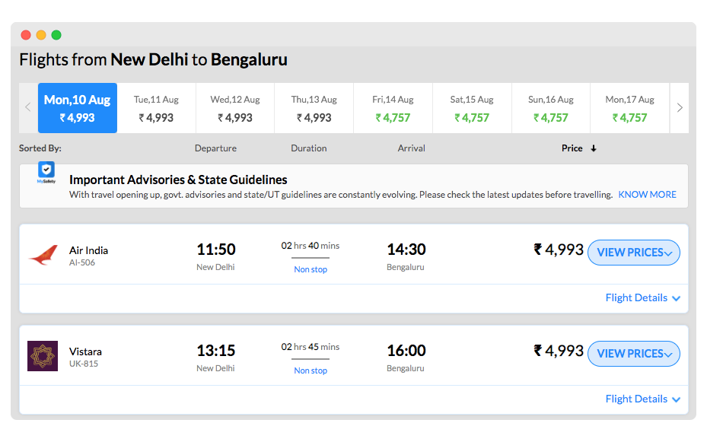

Slide 7
Request JSON:
{
”from” : “New Delhi”,
“to” : “Bangalore”,
“fromDate” : “08-08-2020”
“toDate” : “20-08-2020”
}
SpiceJet
Emirates
Response
JSON/XML
Request Payload
(JSON/XML)
Authentication Key
/ Access Token
Response JSON:
{
”from” : “New Delhi”,
“to” : “Bangalore”,
“flightName” : “Vistara”,
“departureTime” : “9.00 AM”
MakeMyTrip.Com
GulfAir
Vistara
AirIndia

Slide 8
What is REST API?
REST stands for REpresentational State Transfer.
It is an architectural style that defines a set of constraints to be used for creating web services or API.
Web services which are built using REST are called REST API or RESTFul API or web services.
These web services provide communication between computer systems on the Internet.

Slide 9
What is API Testing?
API testing helps in validating the response coming from the Application Programming Interface.
With API testing, you can validate whether the functionality is working correctly or not.

Slide 10



UI Layer
API Exposed
Logic Layer
Data Layer

Slide 11
Why is API Testing Important?
When an application is built, the functionalities are developed first as APIs and then integrated with the frontend layer.
If you wait for the integration to find bugs in the application, then you will start adding cost to the bugs.
The later the bugs are found in the system, the more cost it adds to the application

Slide 12
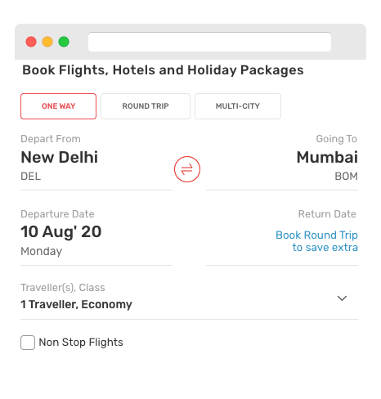
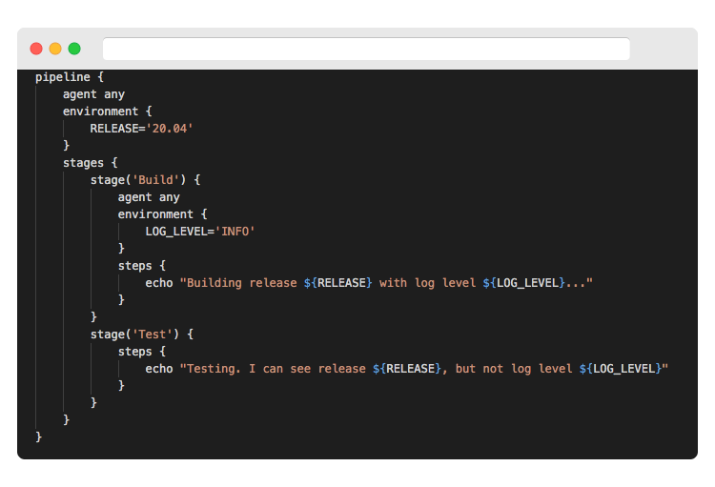
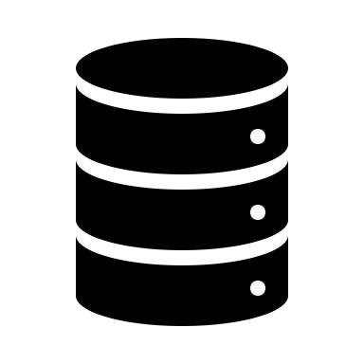
CRUD Operations
Client
Server
POST (Create)
GET (Retrieve/Read)
PUT (Create + Update)
PATCH (Update)
DELETE (Delete)

Slide 13

Call flow
Client
URL/URI
Server
POST (Create)
Example –
Create a user into the system
{
”accountName” : “NobleProg”,
“accountType” : “Savings”
}
Response –
{
“statusCode” : “200 OK”,
“accountId” : “001”
}
Request –
HTTP Method (POST/PUT/GET/DELETE)
Headers
Request Payload
Query/Path Parameter
Response –
Status Code
Response Headers
Payload

Slide 14
Status Code
1xx: Informational - It means the request has been received and the process is continuing.
2xx: Success - It means the action was successfully received, understood, and accepted.
3xx: Redirection - It means further action must be taken in order to complete the request.
4xx: Client ErrorIt means the request contains incorrect syntax or cannot be fulfilled.
5xx: Server ErrorIt means the server failed to fulfill an apparently valid request.

